Slide 1
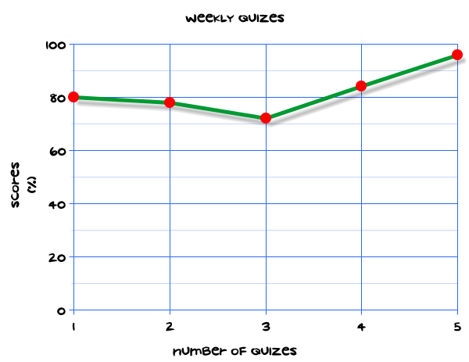
My Statistics Interactive Notebook
Name
Class
Teacher
Term 1 Semester 1
1

Slide 2
Create your own front page
It needs to contain the following –
My number interactive notebook
Name
Class
Teachers Name
Semester 1 Term 1
Page number 1

Slide 3
Contents
Glossary or Formula Page
Page
Date
Description
2
3

Slide 4
Tasks
24
7
30
Essential Question
Questions
Notes
Summary
4
5

Slide 5
24
7
30
Date
Title
EQ –
5

Slide 6
24
7
30
Date
Drawing Scatterplots
EQ –
When is it appropriate to use a Scatterplot to display data.
What is a Scatterplot?
A scatterplot (scatter graph) is used to show bivariate data, particularly where the variables could be related.
For convenience, the scales of a graph or chart usually go up in 1s, 2s, 4s, 5s, 10s and so on.
5

Slide 7
24
7
30
Date
Drawing Scatterplots
EQ –
When is it appropriate to use a Scatterplot to display data.
What is a Scatterplot?
A scatterplot (scatter graph) is used to show bivariate data, particularly where the variables could be related.
For convenience, the scales of a graph or chart usually go up in 1s, 2s, 4s, 5s, 10s and so on.
When would I use a scatterplot?
Use a scatterplot to analyse patterns of the relationship between two sets of continuous data.
5

Slide 8
24
7
30
Date
Drawing Scatterplots
EQ –
When is it appropriate to use a Scatterplot to display data.
What is a Scatterplot?
A scatterplot (scatter graph) is used to show bivariate data, particularly where the variables could be related.
For convenience, the scales of a graph or chart usually go up in 1s, 2s, 4s, 5s, 10s and so on.
When would I use a scatterplot?
Use a scatterplot to analyse patterns of the relationship between two sets of continuous data.
Example:
The local ice cream shop keeps track of how much ice cream they sell versus the noon temperature on that day. Here are their figures for the last 12 days:
5

Slide 9
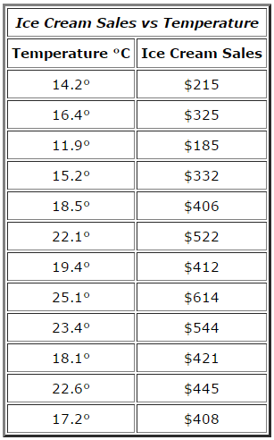
24
7
30
Date
Drawing Scatterplots
EQ –
When is it appropriate to use a Scatterplot to display data.
5

Slide 10
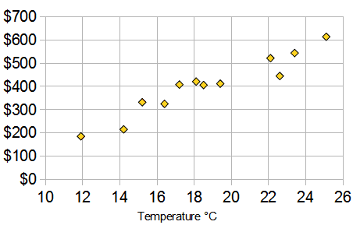
24
7
30
Date
Drawing Scatterplots
EQ –
When is it appropriate to use a Scatterplot to display data.
And here is the same data as a Scatter Plot:
5

Slide 11
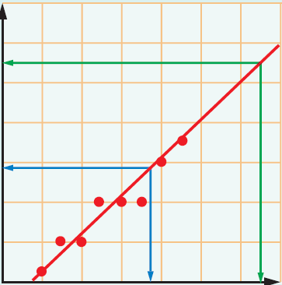
24
7
30
Date
Drawing Scatterplots
EQ –
When is it appropriate to use a Scatterplot to display data.
How do I make a prediction from a Scatterplot?
A line of best fit is a line that shows the general pattern of
points on a graph.
Interpolation is the prediction of a value within the range
of data.
Extrapolation is the prediction of a value outside the range
of the data.
5

Slide 12
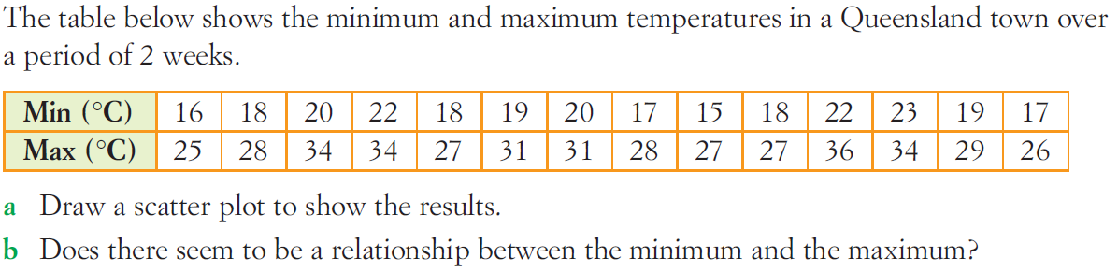
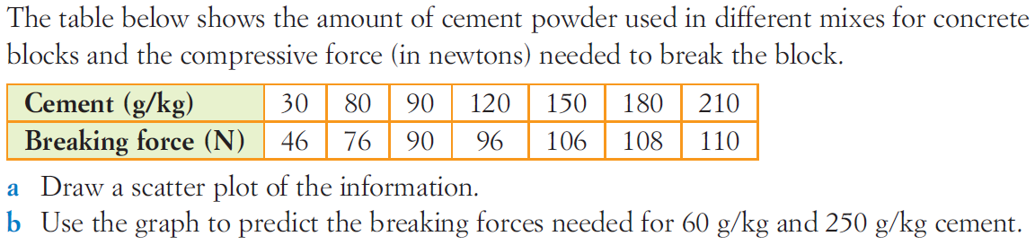
Task

Slide 13
Notes Review
24, 7 ,30
Date
Title
Essential question
Notes complete
Notes complete with colour and diagrams
Questions completed
Contents page filed in
Formula page filled in

Slide 14
Homework
Review your notes and write a summary answering the essential question.

